Slide 1
Hands-Free Image Cropping using Sensors
-Suchintan Pati (18CS10064)
Under supervision of Prof. Partha Pratim Das

Slide 2
Introduction
Human Computer Interaction has been a growing field of research. With the growing popularity of Augmented and Virtual Reality (AR/VR), hand gesture recognition and tracking are topics of interest.
Through this project, we aim to explore these research areas by performing the task of hands-free image cropping. A robust and efficient method is discussed, which can be used in a wider range of hands-free applications.

Slide 3
Topics Covered
Introduction
Objective
Related Work
Background Study
Image Processing
MediaPipe Hands
Approach
Implementation
Future Scope

Slide 4
Objective
The aim of the BTP is to be able to crop an image through a series of hands-free gestures via the aid of sensors/cameras.
Gestures include tracking gesture that is responsible for drawing a bounding area over the intended image to be cropped .
Control gestures that assist the user in achieving the above task.

Slide 5
Related Work
Regional Attention with Architecture-Rebuilt 3D Network for RGB-D Gesture Recognition(RAA3DNET)^{[1]} : proposes 3DCNNs based architecture
Online Detection and Classification of Dynamic Hand Gestures with Recurrent 3D Convolutional Neural Networks^{[2]} : Recurrent 3DCNNs for real time gesture classification.
Real Time Gesture Recognition System for Interaction in Dynamic Environment^{[3]} : Use of hand crafted features to classify hand gestures.
Robust Hand Gesture Recognition Based on Finger-Earth Mover’s Distance (FEMD) with a Commodity Depth Camera^{[1]}: proposes a metric, FEMD, that can distinguish gestures with slight differences.

Slide 6
Gap and Contribution
These papers helped in understanding the different complexities that are involved in the domain of hand gesture recognition. However there were some drawbacks specific to this project:
The latter two approaches discussed above are not robust when subject to a variety of gestures and environments
The former two methods are difficult to train on a custom dataset and they are resource intensive.
MediaPipe Hands model (discussed later briefly) is a solution that provides a foundation to robustly yet efficiently define and identify gestures and track movement.

Slide 7
Background Study
In this section some image processing techniques: Matrix representation of images and color space conversion, have been discussed. This is followed by a brief overview of the MediaPipe Hands solution, that has been applied in this project.

Slide 8
Color Space Conversion
RGB images are represented by 3 dimensional matrices. Each pixel consists of three stream of colours, where each stream(red, blue and green) is encoded in 8 bits. Grayscale images are represented by 2 dimensional matrices, where each cell value, Gray(x,y), denotes the intensity of the pixel. Grayscale images are used more extensively in image processing.
RGB to Grayscale
The luminosity method gives more weight to the green component, followed by red and blue.
Gray(x, y) = 0.299 ∗ R(x, y) + 0.587 ∗ G(x, y) + 0.114 ∗ B(x, y)
Grayscale to RGB:
The same gray value is assigned to all three streams.
R(x, y) = G(x, y) = B(x, y) = Gray(x, y)
*(R(x,y), G(x,y) and B(x,y) represent red, blue and green of pixel at (x,y) coordinate)

Slide 9
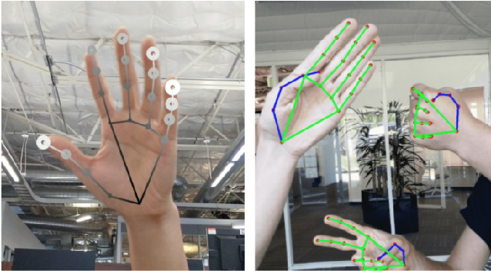
MediaPipe Hands
MediaPipe Hands: On-device Real-time Hand Tracking^{[1]} by Google Research proposes a novel highly optimized method to detect and track hands. The hand-landmark model provide key-points that identify specific parts of hands for example, the joints and tips

Slide 10
Architecture
The solution consists of two models working together: a palm detector model and a hand landmark model.
• The palm detector module, also called as BlazePalm, takes input as an image frame and returns a bounding box containing the hand.
• The hand landmark module takes the bounding box as input and performs precise land-mark localization of 21 2.5D coordinates inside the detected hand regions via regression. Some examples of these points are: wrist, index finger tip, index finger dip, etc.

Slide 11
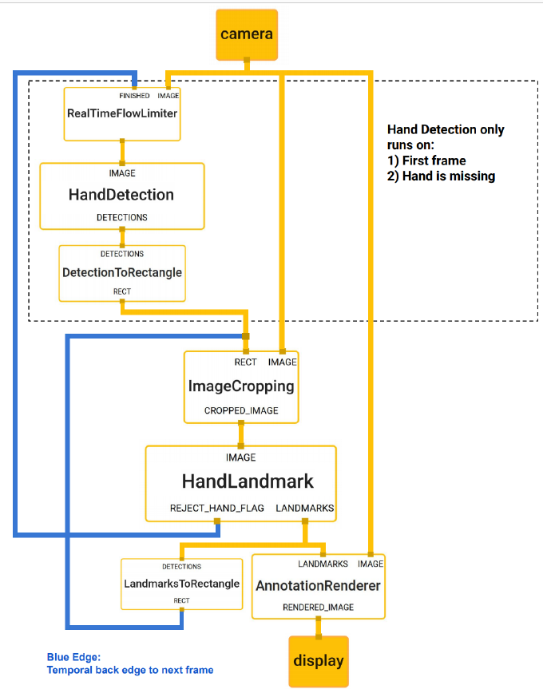
Optimization
The palm detector module runs only for the first frame and when the hand is not detected by the hand landmark model.
This saves a significant amount of computation as for the majority of the frames, only the hand landmark model, which is less computationally heavy, is active.
The hand land model also outputs a scalar denoting the confidence of hand presence in the input cropped image. If this confidence falls below an adjustable threshold, the palm detector module is invoked.

Slide 12
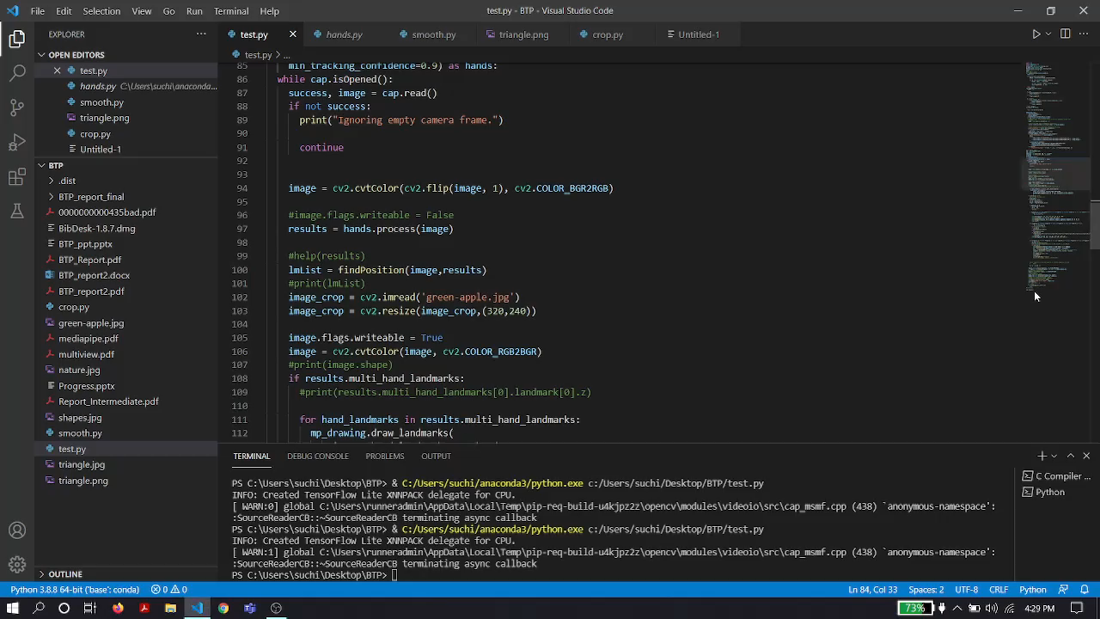

Slide 13
Implementation
The task of hands-free image cropping was achieved with the help of MediaPipe Hands model and various image processing techniques. The following steps are performed:
An input frame (from webcam) is captured from which the keypoints are obtained from the hand landmark model.
Identify gestures from the keypoints obtained.
Perform the cropping of image after tracking the movement of index finger.

Slide 14
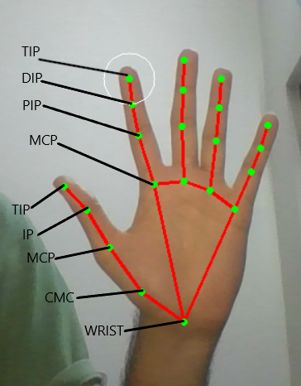
Keypoints Collection
MediaPipe Hands solution, as discussed previously, is applied on the input frame to obtain the 21 x and y landmark coordinates. These points are also displayed on the screen. The 21 landmarks contain the coordinates of all the joints and tips of all fingers.
CMC – Carpometacarpal joint
MCP - Metacarpophalangeal joint
IP - Interphalangeal joint
DIP - Distal Interphalangeal joint
PIP - Proximal Interphalangeal joint

Slide 15
Gestures
The stored coordinates of the 21 land marks are utilized and the following gestures have been defined:
Draw Gesture
Clear Screen Gesture
Crop Gesture
The gestures are recognized based on the relative position of these finger joints. A finger is said to be “up” if the Y coordinate of TIP is greater than that of the PIP. After identifying the gesture, the corresponding action is performed.

Slide 16
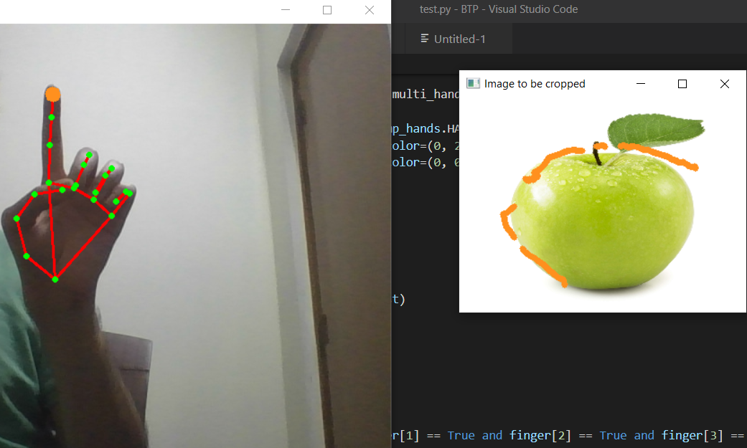
Draw gesture
Description
The gesture is triggered when the user shows one index finger.

Slide 17
Draw gesture
Action
The coordinates of the index finger tip in the current frame is added to a list(say points[]).
As the user moves his index finger freely in front of the camera, the corresponding shape consisting of points with x-y coordinates is stored.
A line is drawn(on the image to be cropped) dynamically between the previous and current position of the index finger tip for each frame. This is done by drawing line on a separate image matrix,(named as image canvas), consisting of zeroes initially, convert to grayscale to perform inverse binary thresholding, convert back to RGB, followed by bitwise AND operation on the original image.

Slide 18
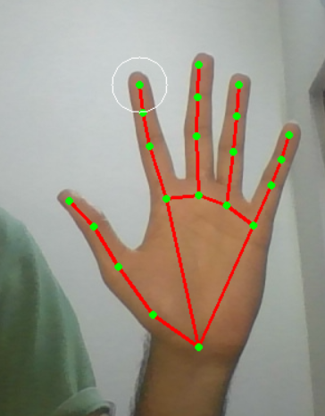
Clear Screen Gesture
Description
The gesture is triggered when the user shows all five fingers.
Action
The screen and the list containing previously drawn points are cleared. The screen is cleared by filling the image canvas with color black (reinitialize matrix with 0’s), and performing the same operations as in draw gestures.

Slide 19
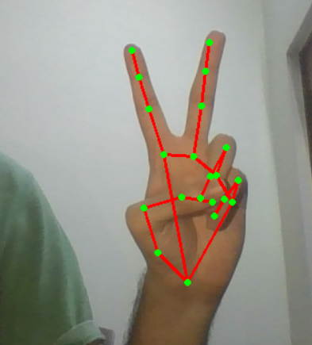
Crop Gesture
Description
The gesture is triggered when the user shows the index and the middle fingers (victory sign).
Action
A contour is drawn on a mask, which is a matrix initialized with zeroes, by joining the points stored in the list (points[]) during the drawing phase.
A closed figure is obtained by joining the first and the last point. This figure is filled with a color. Now all the pixels in the mask outside this figure are zeroes

Slide 20
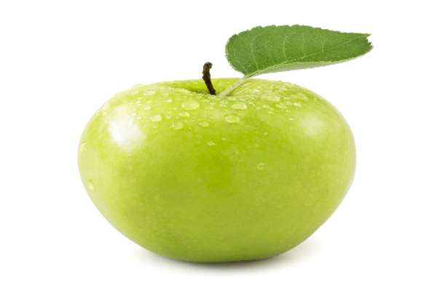
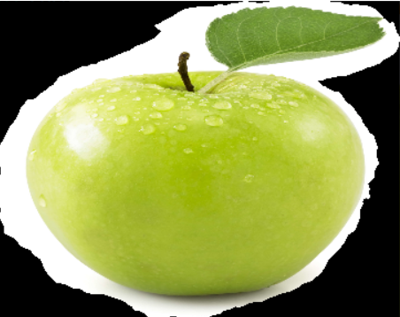
Crop Gesture
Action(contd.)
The cropped image is then extracted by performing bit-wise and operation on the image to be cropped with itself and the mask.
Original Image
Cropped Image

Slide 21
Handling Noise
There were many observed jitters during the drawing phase due to variety of factors during the detection and the tracking phase. These sudden movements caused erratic drawing of points leading to inaccuracy.
This was avoided by recording only points that were close to each other, where a distance threshold determines closeness.
if distance(x_{prev}, y_{prev}, x_{curr}, y_{curr}) ≤ threshold then
(x_{curr}, y_{curr}) appended to points[ ]
Now if the user moves the index finger very quickly or there are sudden jitters due to imperfect detection, the corresponding outlier point(s) will be ignored and the drawing phase continues. This resulted in more separated points, where separation depends on the speed with which the user moves his hand (figure in next slide).

Slide 22
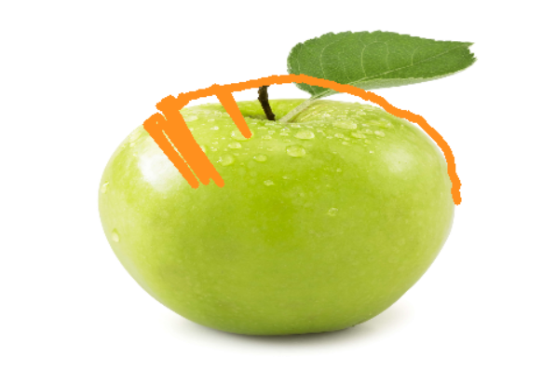
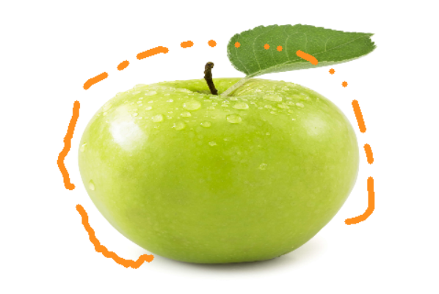
Handling Noise
Before
After

Slide 23
Observations
The field of view of the webcam is quite low. This means the hand will easily move out of the frame, and the image to be cropped has to be resized to almost half the field of view of the webcam.
The external factors also play a major role in determining the detection and tracking confidence. For example, color plays a huge factor: an orange or close to skin color background can deter the performance. Hence there is some reduction in performance if the hand is in front of the face.
The borders of the cropped image are not smooth. This is caused due to slight inaccuracies in the detection of the tip of the index finger.

Slide 24
Future Scope
The use of depth sensing cameras can help in the following ways:
The field of view issue can be resolved by using a sophisticated sensors, like Intel RealSense and Kinect v2.
The case of external factors (background, skin color) can be addressed with the use of depth information in addition to RGB. This would help to segregate the hand, which is closer to the camera, from the background improve the hand detection.

